Slide 1





Online Market
SYSTEM ANALYSIS AND DESIGN

Slide 2



1
Gana Dokmak
A23MJ0004
Group 12
2
MA YIMAN
A23MJ4005
3
Zinat Ferdous
A23MJ0017

Slide 3

01
Project Overview

Slide 4
KEY FEATURES
“
Goal
Intuitive user interface
Create a robust online marketplace facilitating seamless transactions between buyers and sellers.
Advanced search functionality
Comprehensive seller profiles
Secure payment gateway
Review and rating system
Personalized recommendations
Seller administrative tools

Slide 5
Target Users:
Sellers looking to reach a wider audience.
Buyers seeking a user-friendly and secure shopping experience.
Through this platform, we aim to provide a user-friendly interface that streamlines product showcasing, purchase processes, and seller-buyer communication, ultimately enhancing the online shopping experience. This initiative aligns with our group’s dedication to fostering online trade and community connectivity.

Slide 6
Our approach to achieving these objectives will involve several key phases:
Conduct market research to understand
the needs and preferences of sellers and buyers.
Requirement
gathering and analysis
Create wireframes and prototypes to visualize the user
interface and functionality of the Online Marketplace.
Design and prototyping
Utilize cutting-edge web technologies to build a scalable,
secure, and user-friendly platform.
Development
Conduct extensive testing to ensure the platform's functionality and gather feedback for further improvements.
Testing and feedback
Roll out the Online Marketplace prototype to users and provide comprehensive review to ensure optimal utilization.
Deployment

Slide 7
02
Graphical User Interface

Slide 8

Signup, Shopping cart
Highlights promotional offers
and popular products.
Features product listings,
search bar, and categories.

Slide 9
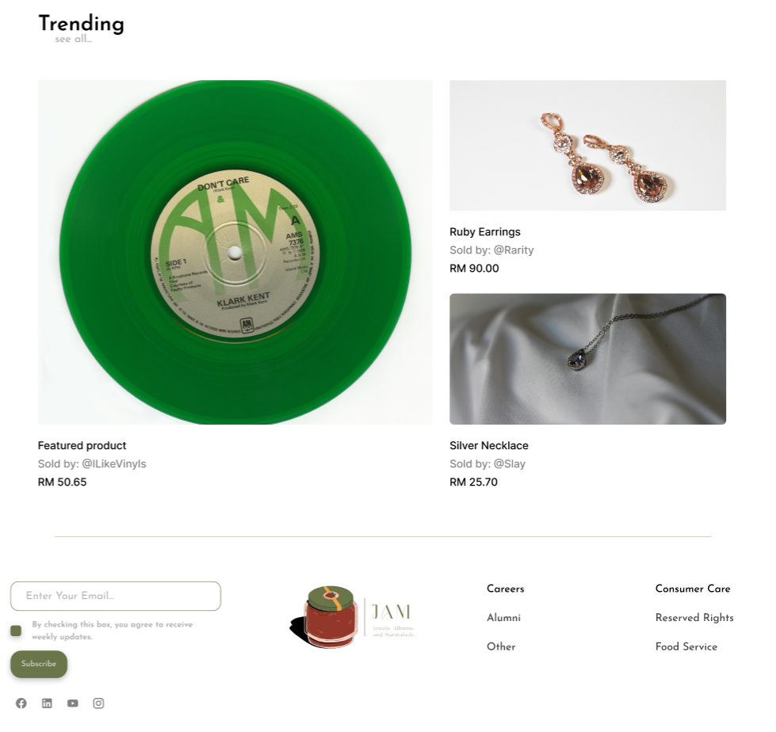
Recommend product, trending
Quick access to products
Subscription, service list

Slide 10
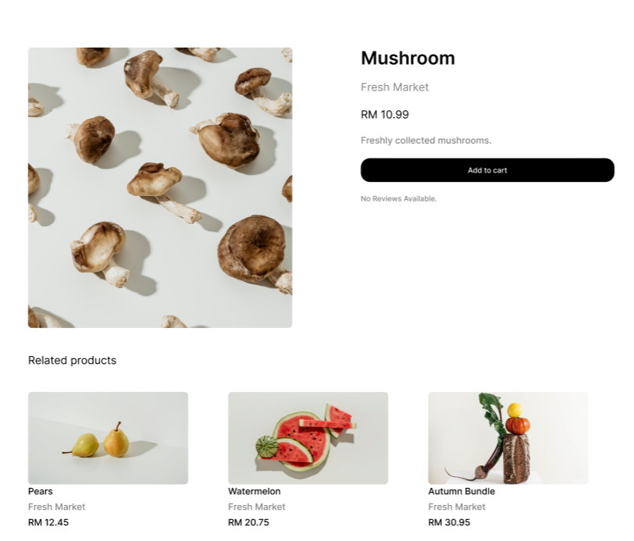
High-quality images, detailed descriptions
pricing information
Options for adding to cart
Related product recommendation

Slide 11
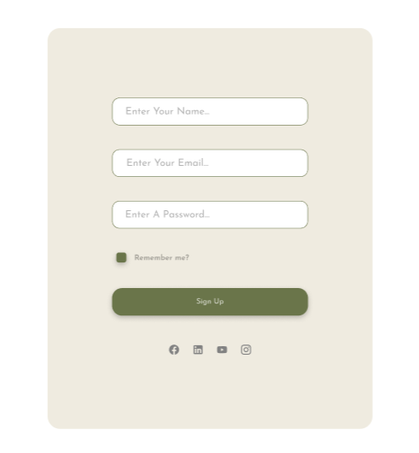

login interface
Website introduction

Slide 12
03
Conclusion

Slide 13
Summary of Benefits
Improved user experience through a streamlined interface.
Enhanced trust and transparency with detailed profiles and reviews
Efficient transactions with secure payment gateways
Increased engagement with personalized recommendations

Slide 14
Future Plans
strategies to attract more users.
3
Expansion of features and functionalities.
2
Continuous improvement based on user feedback.
1

Slide 15


Slide 16
Thank you

